Slide 1
Mobile Ticketing - Lessons Learned
Hear from peers that went mobile-first and other strategies

Slide 2
MODERATORS
Liz Kelley, Paciolan
PRESENTERS
Chad Erwin, Grand Rapids Griffins
Brennan Garcia, Kansas State University
Dianne Whitehair, University of Texas at Austin Performing Arts
Justin Gunter, University of Alabama

Slide 3
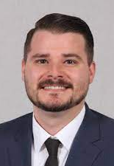

Chad Erwin
Grand Rapids Griffins

Slide 4
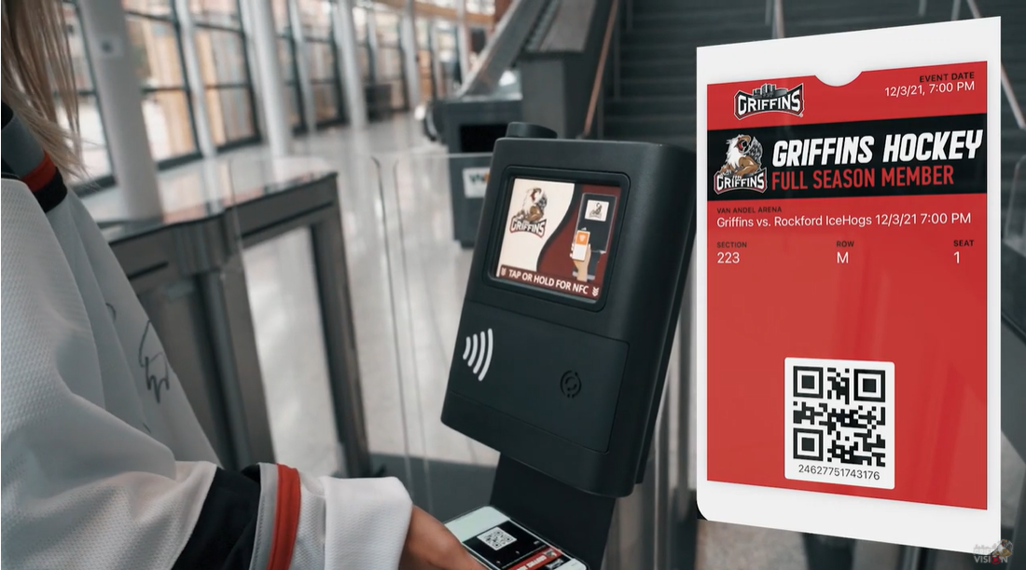
WHO ARE WE?
AHL – how long has club been around
New Pac client
  Plan from the beginning was to go 100% mobile
  Made conscious decision to NOT go NFC

Slide 5
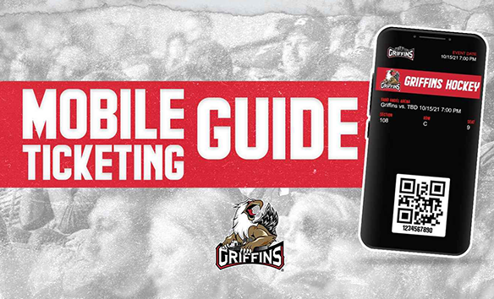
APPROACH
Link to web pages in communications
Screenshare videos / tutorials
Rookie Camp for new STH’s
Ticket Exchange Event
Digital Dashboard
Alvarado Pedestals

Slide 6
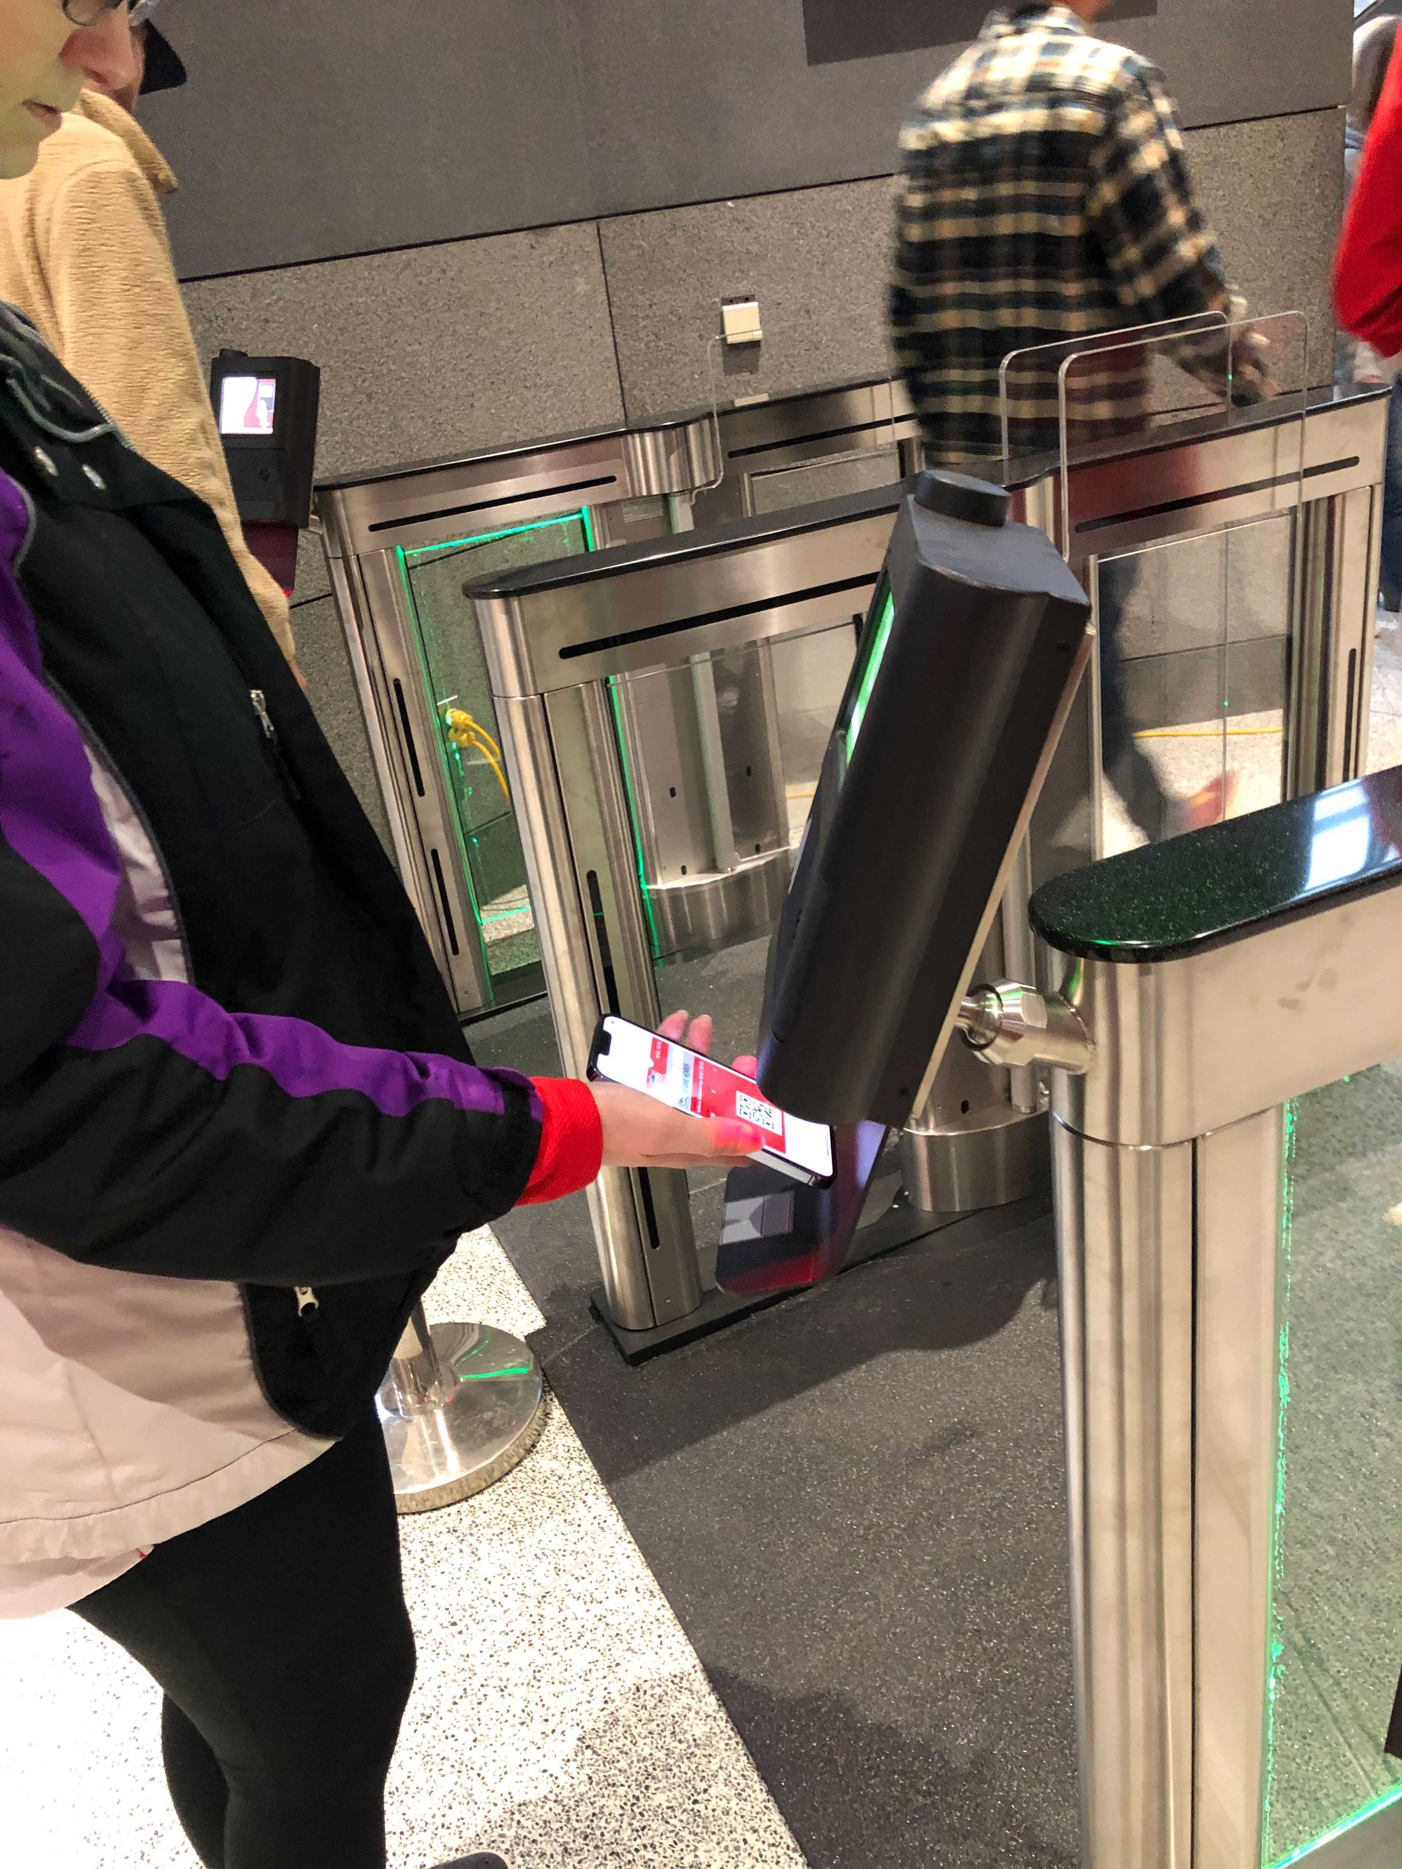
CHALLENGES
Focused Communication Tactics
Apple Pay vs. GPay

Slide 7
SUCCESSES / LESSONS LEARNED
Really hone in on communication/ education on Android/Google
Update FAQ often
Postseason Survey to take suggestions
Notes:
Right now it's early in our season to gauge the success we've had using these tools, but our first game of the season on the new system was a sellout and went off without a hitch. We communicated many times to fans to download tickets to their wallet which helped awareness. We've seen a larger uptick in single-game purchases and have positive feedback with the change to mobile (100% mobile ticket delivery). I think it's tough to gauge how business can compare from previous seasons with the hesitancy still around COVID. We try to use web tracking, email open, and click rates to re-target fans to get them to commit to purchasing tickets. We've made sure to make the process simple so we can sell the majority of our tickets online. We've also seen a positive adoption of mobile tickets for group sales giving them greater control of their tickets as well as allowing us to know more fans within that group as tickets are transferred to them. We look forward to continuing to grow more with all the new tools we have.

Slide 8
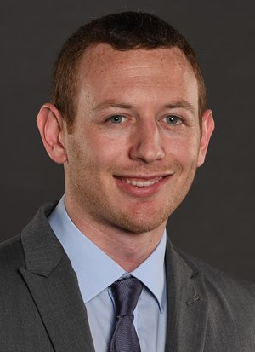

Brennan Garcia
Kansas State University

Slide 9
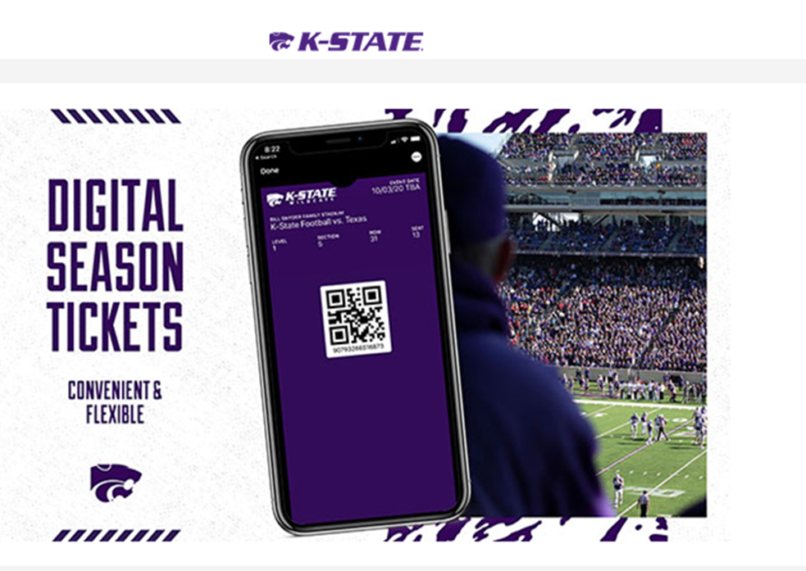
APPROACH
Public Tickets
‘Digital Tickets’ rather than ‘All Mobile’
  Offered the option to go mobile, or receive print-at-home tickets
  Accommodating to our loyal fans
  Premium seat holders had the additional option to receive a season ticket card
Student Tickets
Previously, received a TVL email 48 hours prior to each game
Now, must login to the Sidearm app to add NFC tickets to their wallet
Notes:
Sponsorship opps – using PAH and mobile headers on ticket template – creating more templates based on area and game

Slide 10
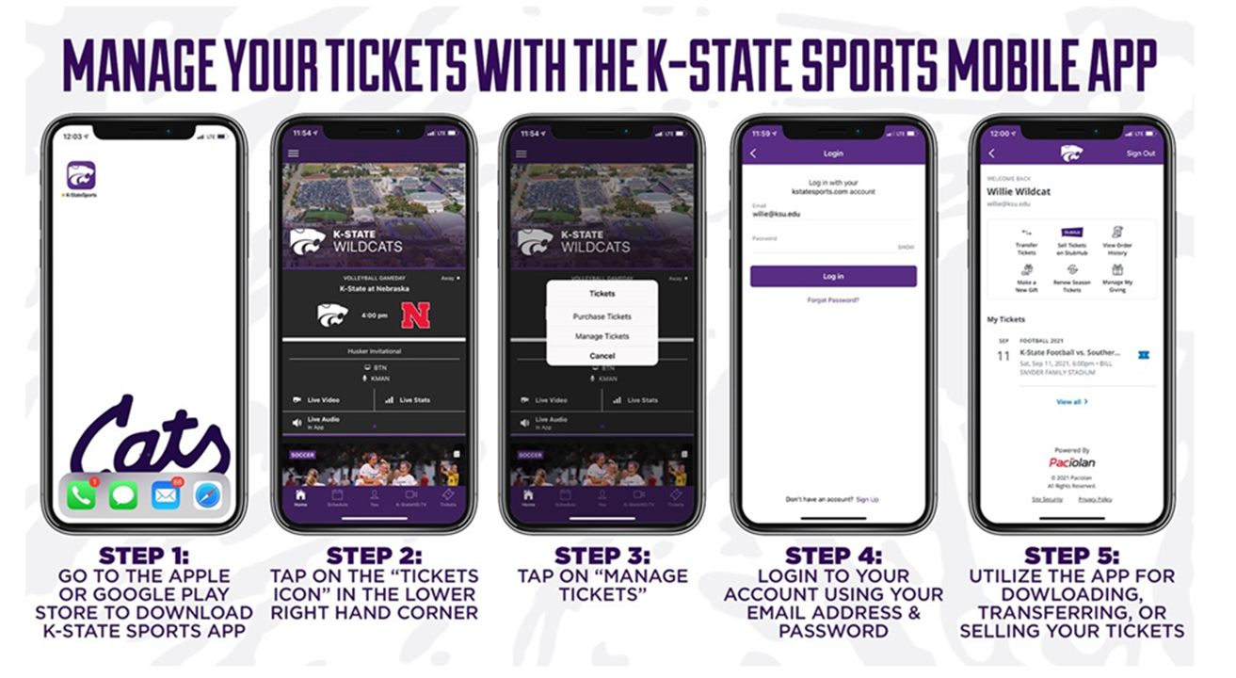
EDUCATION & IMPLEMENTATION
Created a dedicated webpage for education containing:
  Instructional Videos
  Step by step graphics
  Links to download the K-State Sports App
  FAQ’s
Pushed fans to access tickets via Sidearm App
Invested in pedestal scanners for ease of entry

Slide 11
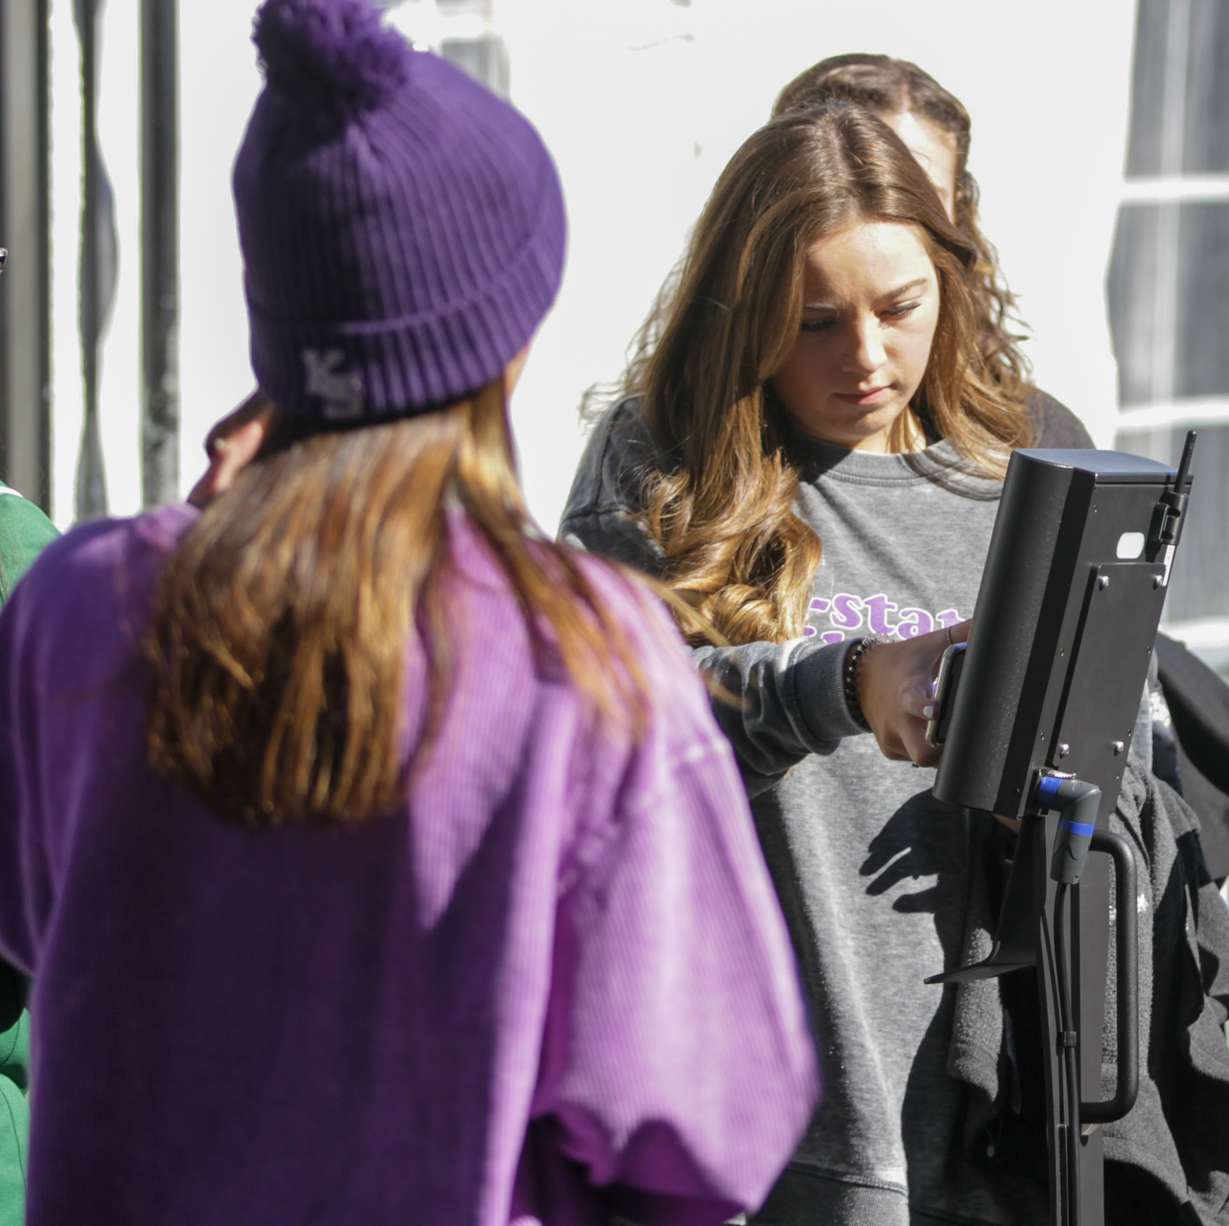
PROGRESSION
2021 Football Ticket Distribution Stats:
81% of tickets sent print-at-home
5% went mobile
14% received a card
2022 YTD Football Ticket Distribution Stats:
60% of 2022 tickets are set for mobile delivery
31% are set for print-at-home
9% have opted for physical tickets
Notes:
Do you have any pix of the pedestal in use? THIS IS JUST A PLACEHOLDER

Slide 12
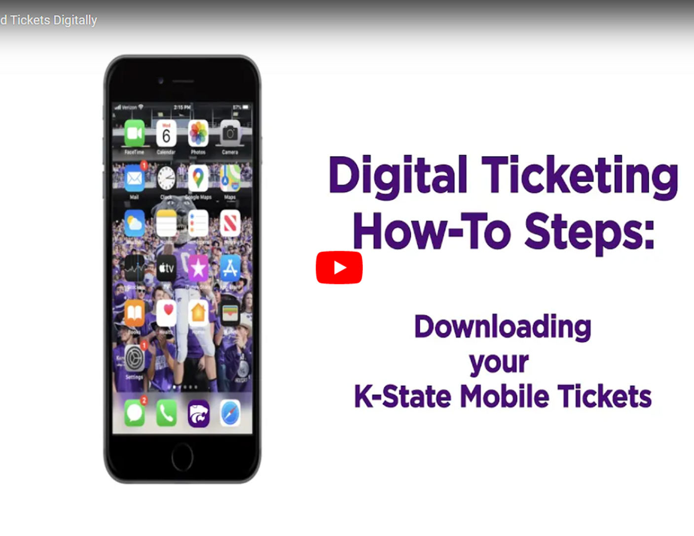
SUCCESSES & LESSONS LEARNED
In our circumstance, we had to crawl before we could run
The more education you can provide, the more comfortable the fans become
Digital Dashboard
  Saw increases in mobile ticket quantities and download % as season progressed
  Had over 90% of tickets downloaded to wallets before the last three home games
Sidearm app integration is an integral part to growing numbers
Notes:
Top digital dashboard numbers

Slide 13
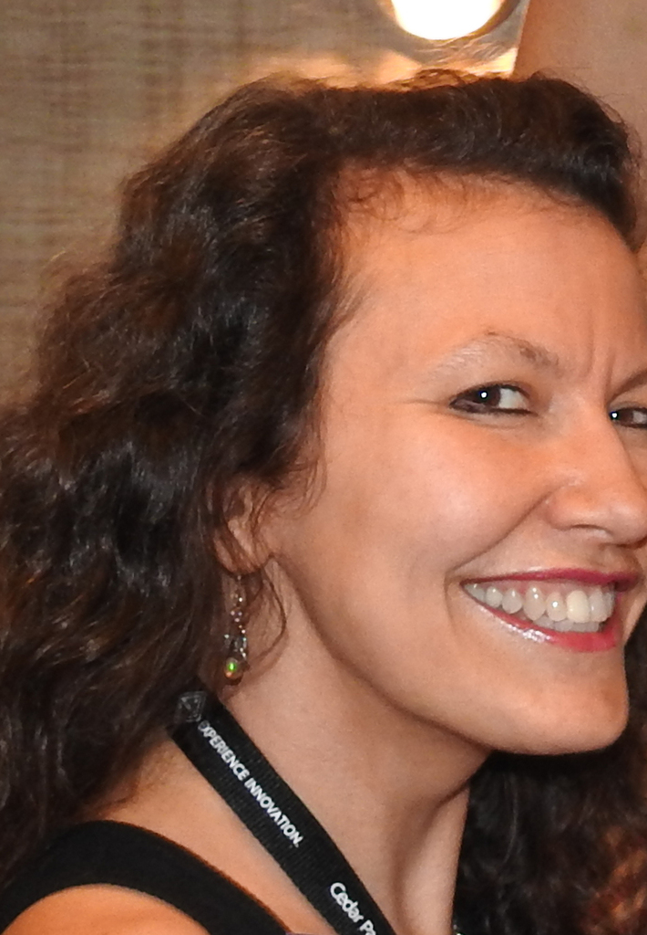

Dianne Whitehair
University of Texas at Austin
Performing Arts

Slide 14

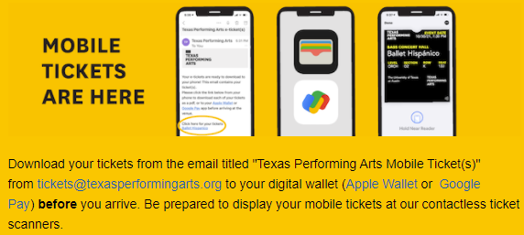
APPROACH
100% Mobile + NFC
Know Before You Go emails
YouTube videos
Notes:
Need a TPA KBYG email

Slide 15
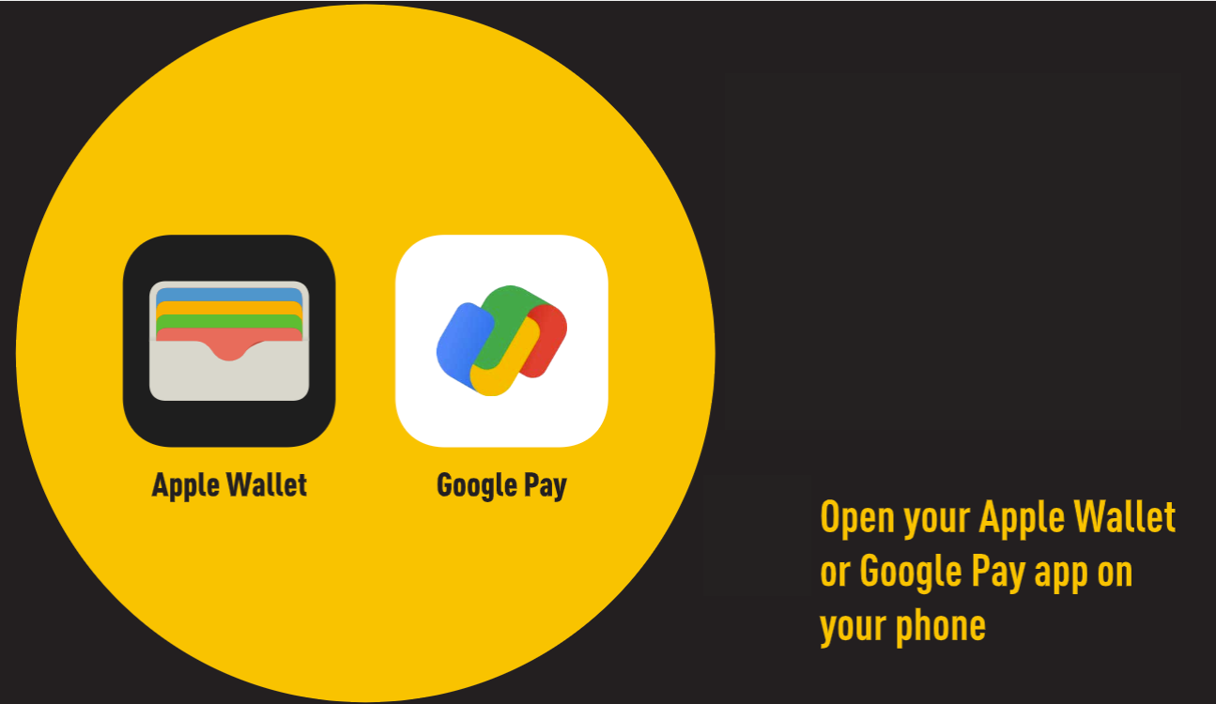

CHALLENGES
Construction Relocations
Postponed Events – Connected Passes
BAA / Pac Integration
  Transfer cutoff at 2 hours
Brokers – delayed delivery

Slide 16
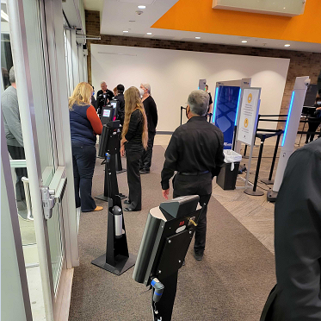
SUCCESSES / LESSONS LEARNED
Image on Alvarado pedestal – place phone here
Consistent messaging on eVenue (“Log In” vs. “My Account”)
Surveys

Slide 17
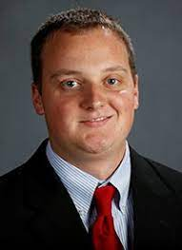

Justin Gunter
University of Alabama

Slide 18
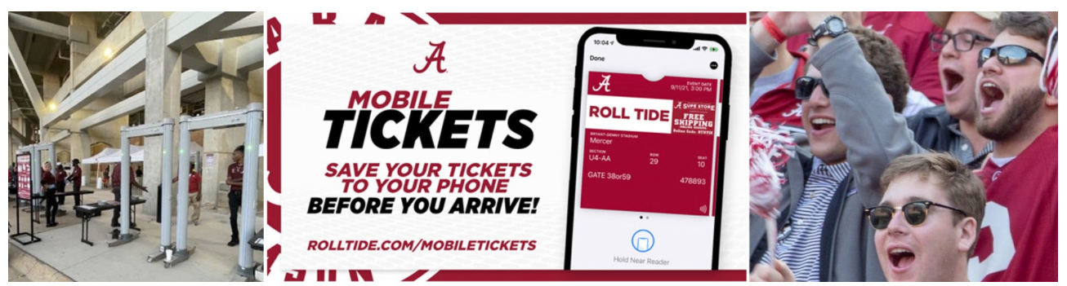
APPROACH
Mobile ONLY with NFC
Educated approximately 20% of fans in 2020
Strong communication / education pieces
Learned a lot from game 1

Slide 19
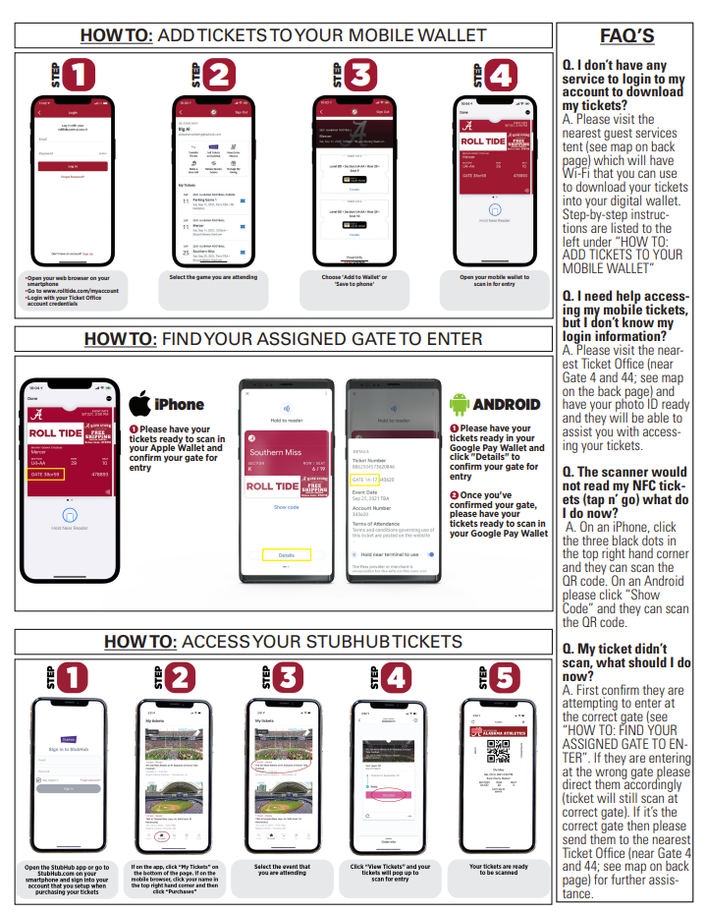
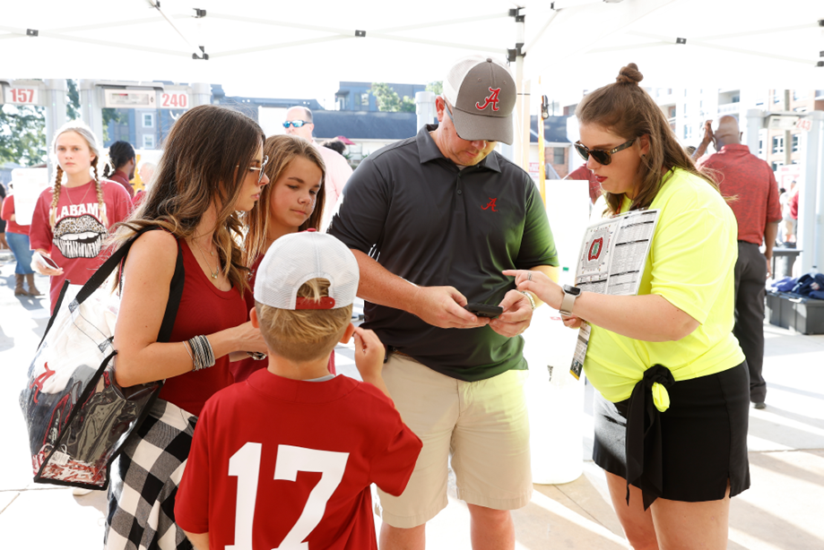
APPROACH
80 volunteers from the Athletic Dept.
Installed public Wi-Fi and charging stations
Increased mobile ticket signage
Temporary tents

Slide 20
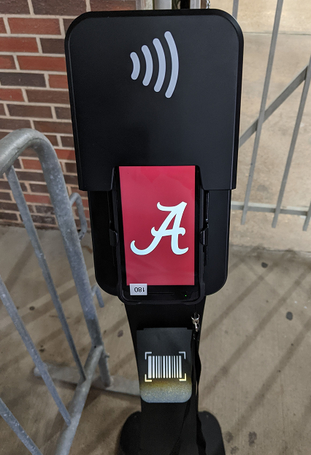
CHALLENGES
QR code vs. NFC fan education
Needed faster entry points
20 new pedestals added

Slide 21
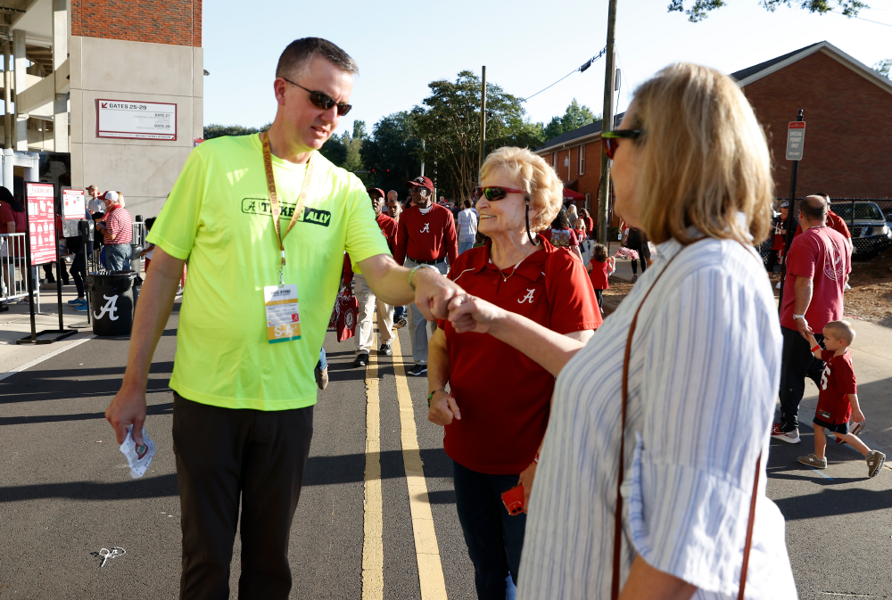
SUCCESSES & LESSONS LEARNED
All hands on deck – starts at the top!
Game 2 lines broke before kickoff
Increased digital downloads from 70% for game 1 up to 92% later in the season.
Notes:
Top digital dashb

Slide 22
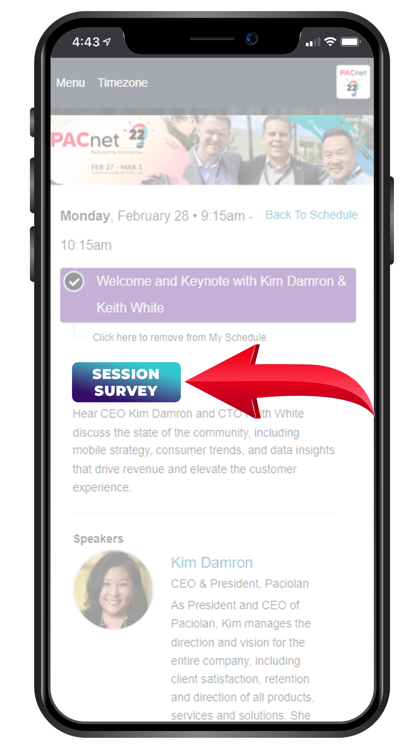
THANK YOU!
QUESTIONS?
Please complete the online session evaluation.

